Slide 1
E Learning Session – Burns By Dr. Nirmala Perera
Computer Designing by Dr. Udara Senarathne

Slide 2

Objectives…
You should utilize this FLS to achieve the following;
Define burn injuries
Identify above injuries by their features
Interpret features of causative agents of injuries.
Interpret circumstances of causation of above injuries.
Identify medico legal significance of those injuries

Slide 3
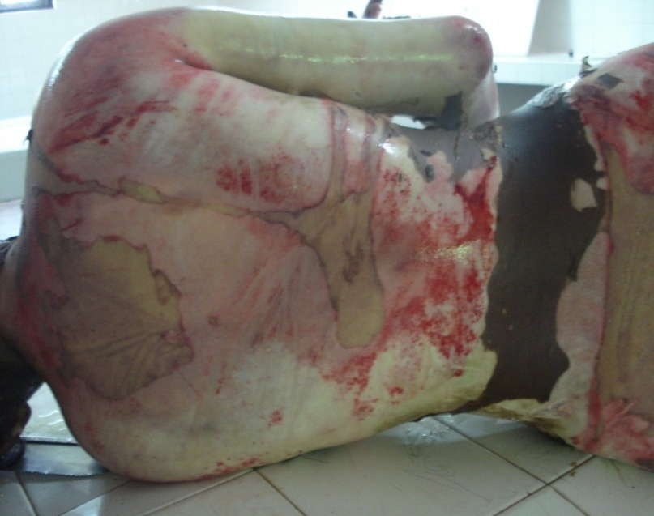
Burns …
Damage to the tissues arising from application of heat is commonly encounter in Forensic pathology and distinction between ante mortem and post mortem burns may have serious criminal aspects.

Slide 4

Fact file…
There are different types of burns such as scalds, burns from dry heat, acid and alkali burns.

Slide 5

Types of burns
Scalds
Dry burns
Corrosive burns

Slide 6
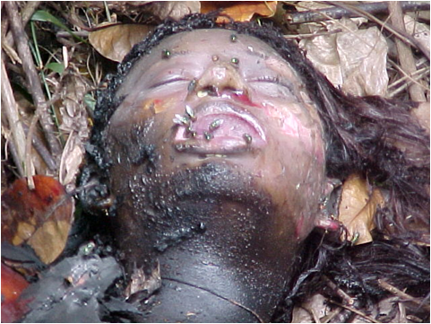
Case Scenario…
This 27 year old woman man was found dead with burn injuries in a shrub area.

Slide 7
1. Which of the following guide you to determine the death of this women is due to ante mortem burn injuries? Answers :
Red base of burn injuries .
Presence of pale blisters.
Cherry pink hypostasis .
Soot particles in the stomach with saliva .
Presence of fatal skull fracture .
Soot in the brochiols.
Co high concentartion in the blood.
Presence of burnt tyres with the body.
Answer

Slide 8
1. Which of the following guide you to determine the death of this women is due to ante mortem burn injuries? Mark true/false.
Red base of burn injuries . (T) Vital reaction is present in ante mortem burns.
Presence of pale blisters. (F) Paleness indicate absence of vital reaction.
Cherry pink hypostasis .(T) Inhaled CO gives pink discoloration.
Soot particles in the stomach mixed with saliva .(T) Inhaled soot has moved to the stomach
Presence of fatal skull fracture . (F) This will indicate homicide
Soot in the bronchioles. (T) Indicate inhalation of soot during breathing.
Co high concentration in the blood. (T) Indicate ante mortem inhalation
Presence of burnt tires with the body. (F) Suggest homicidal burn.

Slide 9
Fact file…
Application of heat on a dead body causes injury and leads to disappearance of injury.
Name following heat artifacts.

Slide 10
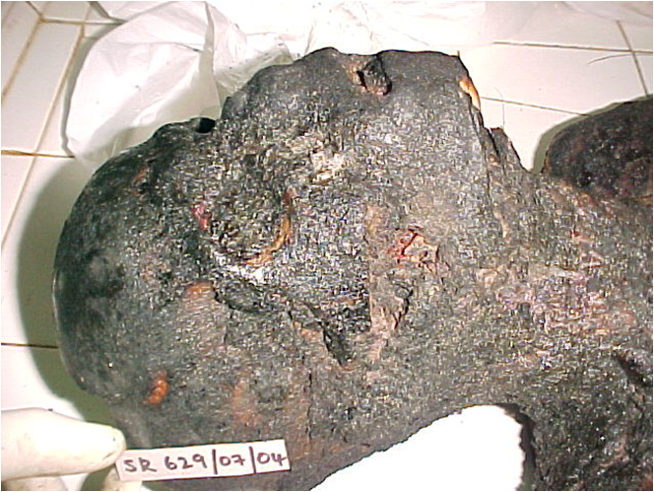
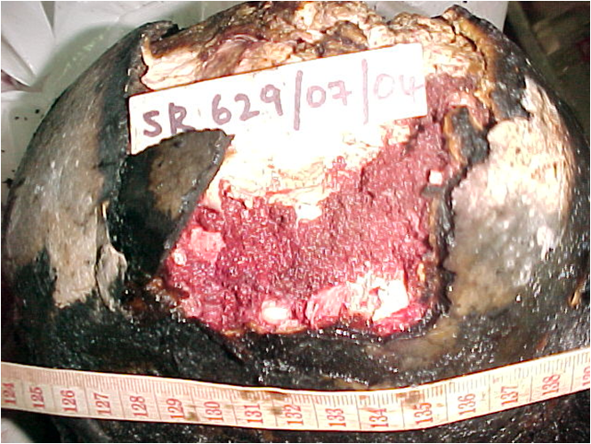
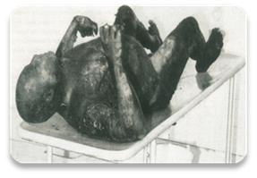

Slide 11
Heat ruptures
Heat haematoma
Pugilistic position

Slide 12

Summary…
Identification of ante mortem burns from post mortem burns will help to determine the circumstances of death.

Slide 13

Now can you?
Define burn injuries
Identify above injuries by their features
Interpret features of causative agents of injuries
Interpret circumstances of causation of above injuries
Identify medico legal significance of those injuries

Slide 14
YES! You Can!

Slide 15

GOOD JOB!

